Slide 1


VISVESVARAYA TECHNOLOGICAL UNIVERSITY Jnana Sangma, Belgaum-590018, Karnataka, INDIA Presentation on
“EMPOWERING BLIND NAVIGATION USING IOT AND GPS TRACKING SYSTEM”
UNDER THE GUIDANCE OF: PRESENTED BY:-
Ms. Tarun Thukral Ali Akbar K (1VJ20EC001)
Asst. professor, ECE Gokul Krishnan R (1VJ20EC004)
E.C.E Department, VVIT Siddarth P (1VJ20EC010)
Sahadev Ambannagol (1VJ21EC400)
VIJAYA VITTALA INSTITUTE OF TECHNOLOGY

Slide 2
CONTENT
Abstract
Introduction
Technology stack
Methodology
Hardware & Software components
Project implementation
Demo video
Objective
Advantages
Applications
Conclusion
References

Slide 3
ABSTRACT
This project aims to empower blind individuals by leveraging IoT (Internet of Things) and GPS tracking systems for efficient navigation. The proposed system integrates real-time location data with sensory feedback devices to provide accurate guidance in unfamiliar surroundings. Through a user-friendly interface, blind individuals can receive audible instructions and tactile feedback, enhancing their spatial awareness and enabling independent mobility. The integration of IoT technology ensures seamless communication between devices, creating a comprehensive solution for effective navigation in diverse environments.

Slide 4
INTRODUCTION
This project aims to empower blind individuals by leveraging IoT (Internet of Things) and GPS tracking systems for efficient navigation.
IoT in Blind Navigation
GPS Tracking System
User Interface and Accessibility
Integration with web application

Slide 5
TECHNOLOGY STACK
Hardware
Arduino UNO
GPS module
ESP8266
APR kit for voice & speaker
Ultra sonic sensor
Gas sensor
Fire sensor
Moisture sensor
Software
embedded C programming
Arduino IDE
Java script
HTML, CSS

Slide 6
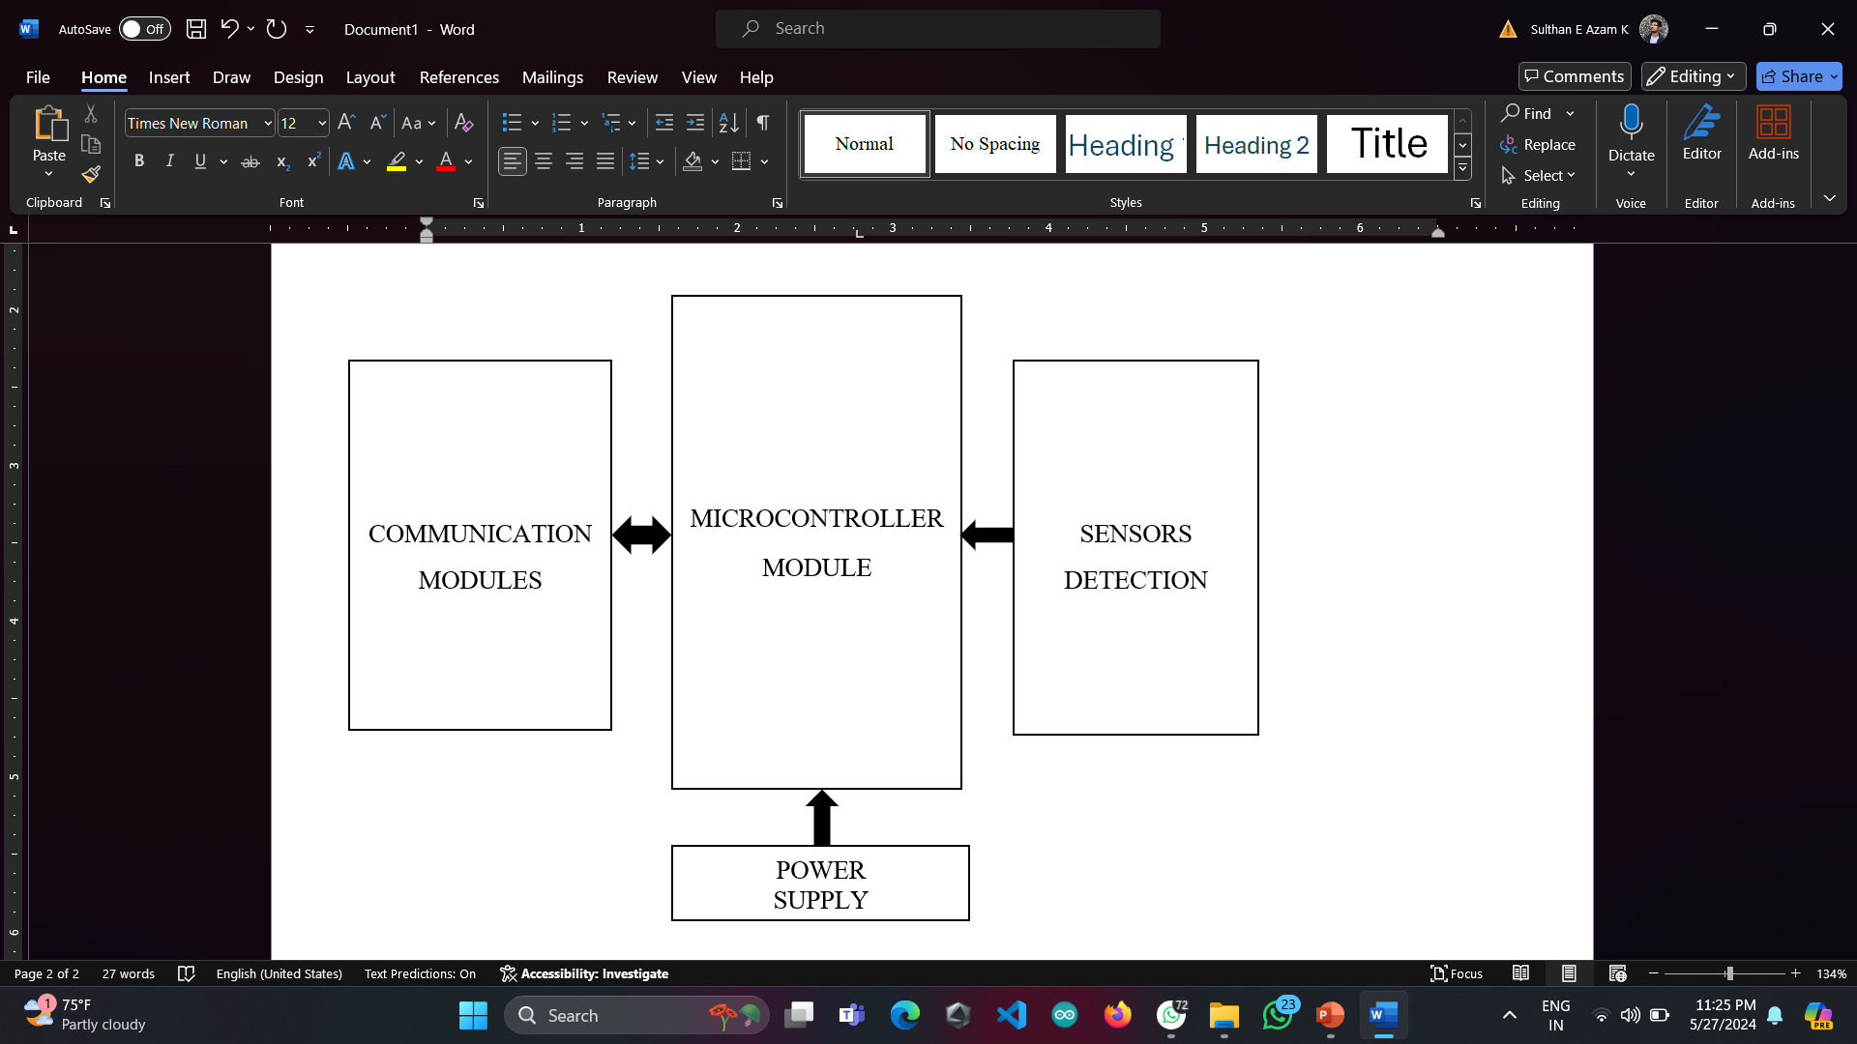
METHODOLOGY

Slide 7
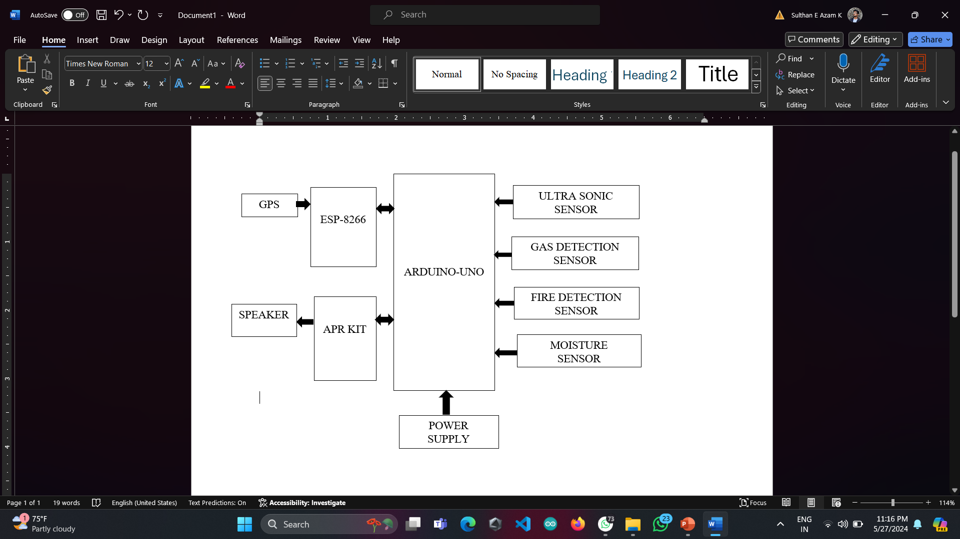
BLOCK DIAGRAM

Slide 8
WORKING OF EMPOWERING BLIND NAVIGATION USING IOT AND GPS TRACKING SYSTEM
Blind Navigator System: Represents the overall system for empowering blind navigation Sensors.
Web Application: Serves as the user interface for the blind user. It may include functionalities like destination input, route selection, etc.
ESP8266 (Microcontroller & IoT Communication Module): Enables communication between the smartphone application and the Arduino, allowing for remote control and monitoring.
APR Kit for Voice (Text-to-Speech Conversion): Sensor's detection converts text-based information (such as navigation instructions) into audible speech for the blind user.
GPS System (GPS Receiver Module): Receives signals from satellites to determine the user's current location and calculate navigation instructions.

Slide 9
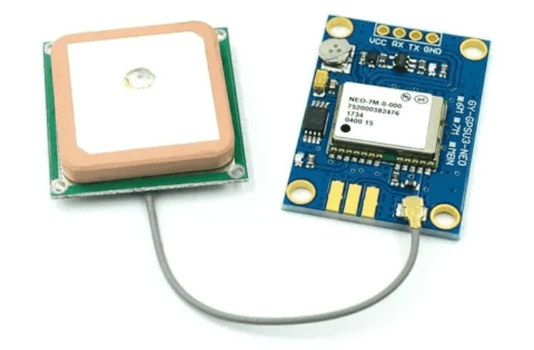
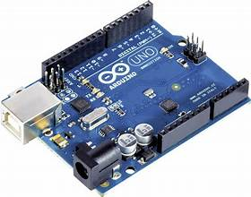
HARDWARE COMPONENTS
2. GPS
1. Arduino UNO
The central part of the system, which processes inputs from all sensors and modules. Common microcontrollers include Arduino ect
Tracks the location of the user. Sends location data to the control unit, which can be triggered by the emergency button.

Slide 10
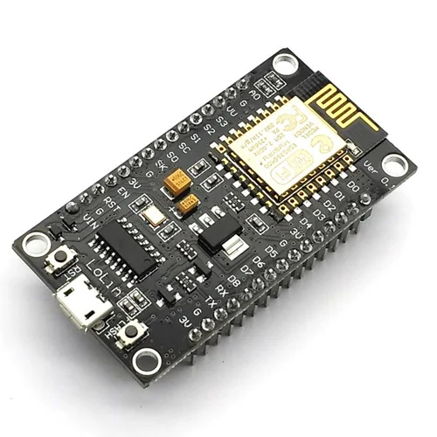
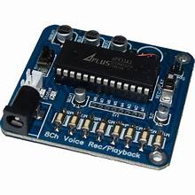
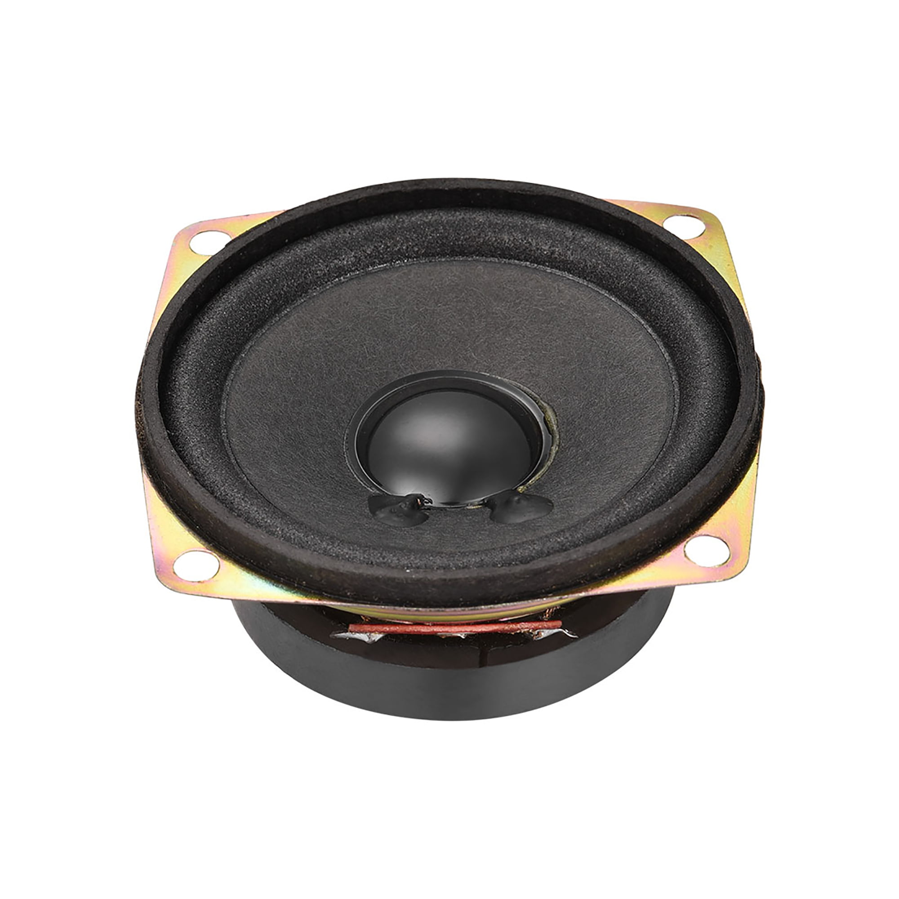
4. APR KIT & SPEAKER
3. ESP 8266
Provides audio alerts to the user based on sensor data of various conditions like obstacles, gas detection, fire, or moisture.
ESP8266 combines a microcontroller with Wi-Fi capabilities, making it suitable for Internet of Things (IoT) projects, Wi-Fi-enabled devices, and other embedded applications.

Slide 11
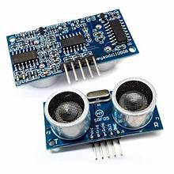
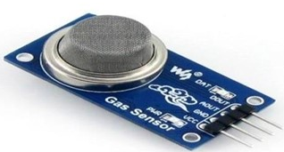
6. GAS SENSOR
5. ULTRA SONIC SENSOR
Detects harmful gases in the environment. Sends data to the control unit for processing and alert generation.
Detects obstacles and measures the distance to ensure safe navigation. Connected to the control unit to send distance data.

Slide 12
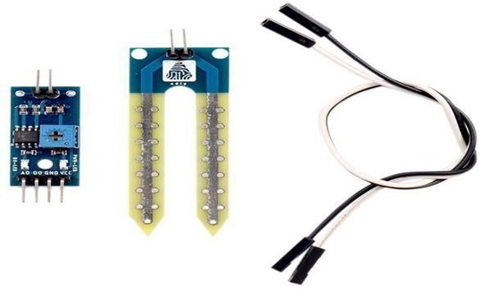
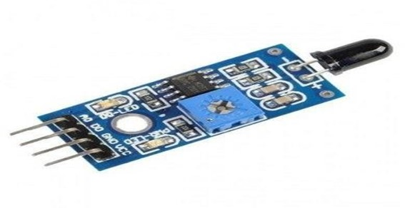
8. MOISTURE SENSOR
7. FIRE SENSOR
Detects the presence of fire or high temperatures.
Sends alert signals to the control unit.
Detects moisture levels, which can be crucial for detecting spills or wet surfaces. Communicates with the control unit to inform the user.

Slide 13
SOFTWARE COMPONENTS
1. Arduino IDE 2. Embedded C
3. HTML, CSS
4. JAVA SCRIPT- JS

Slide 14
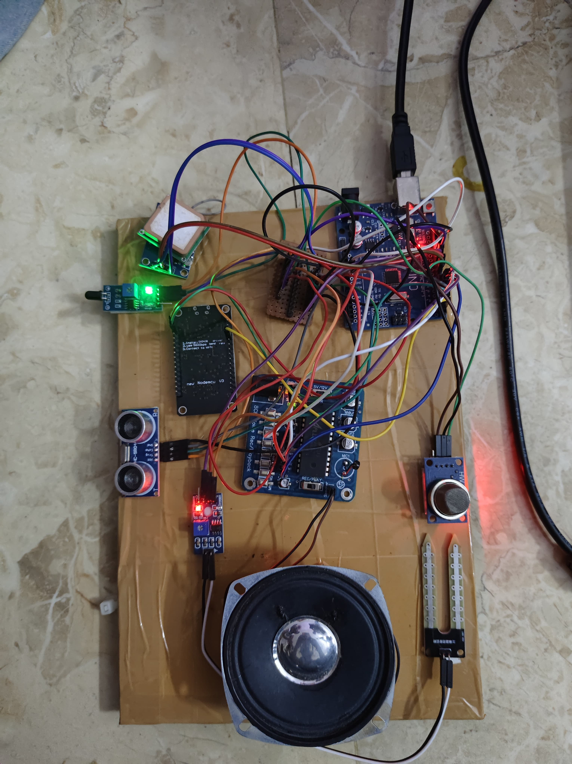
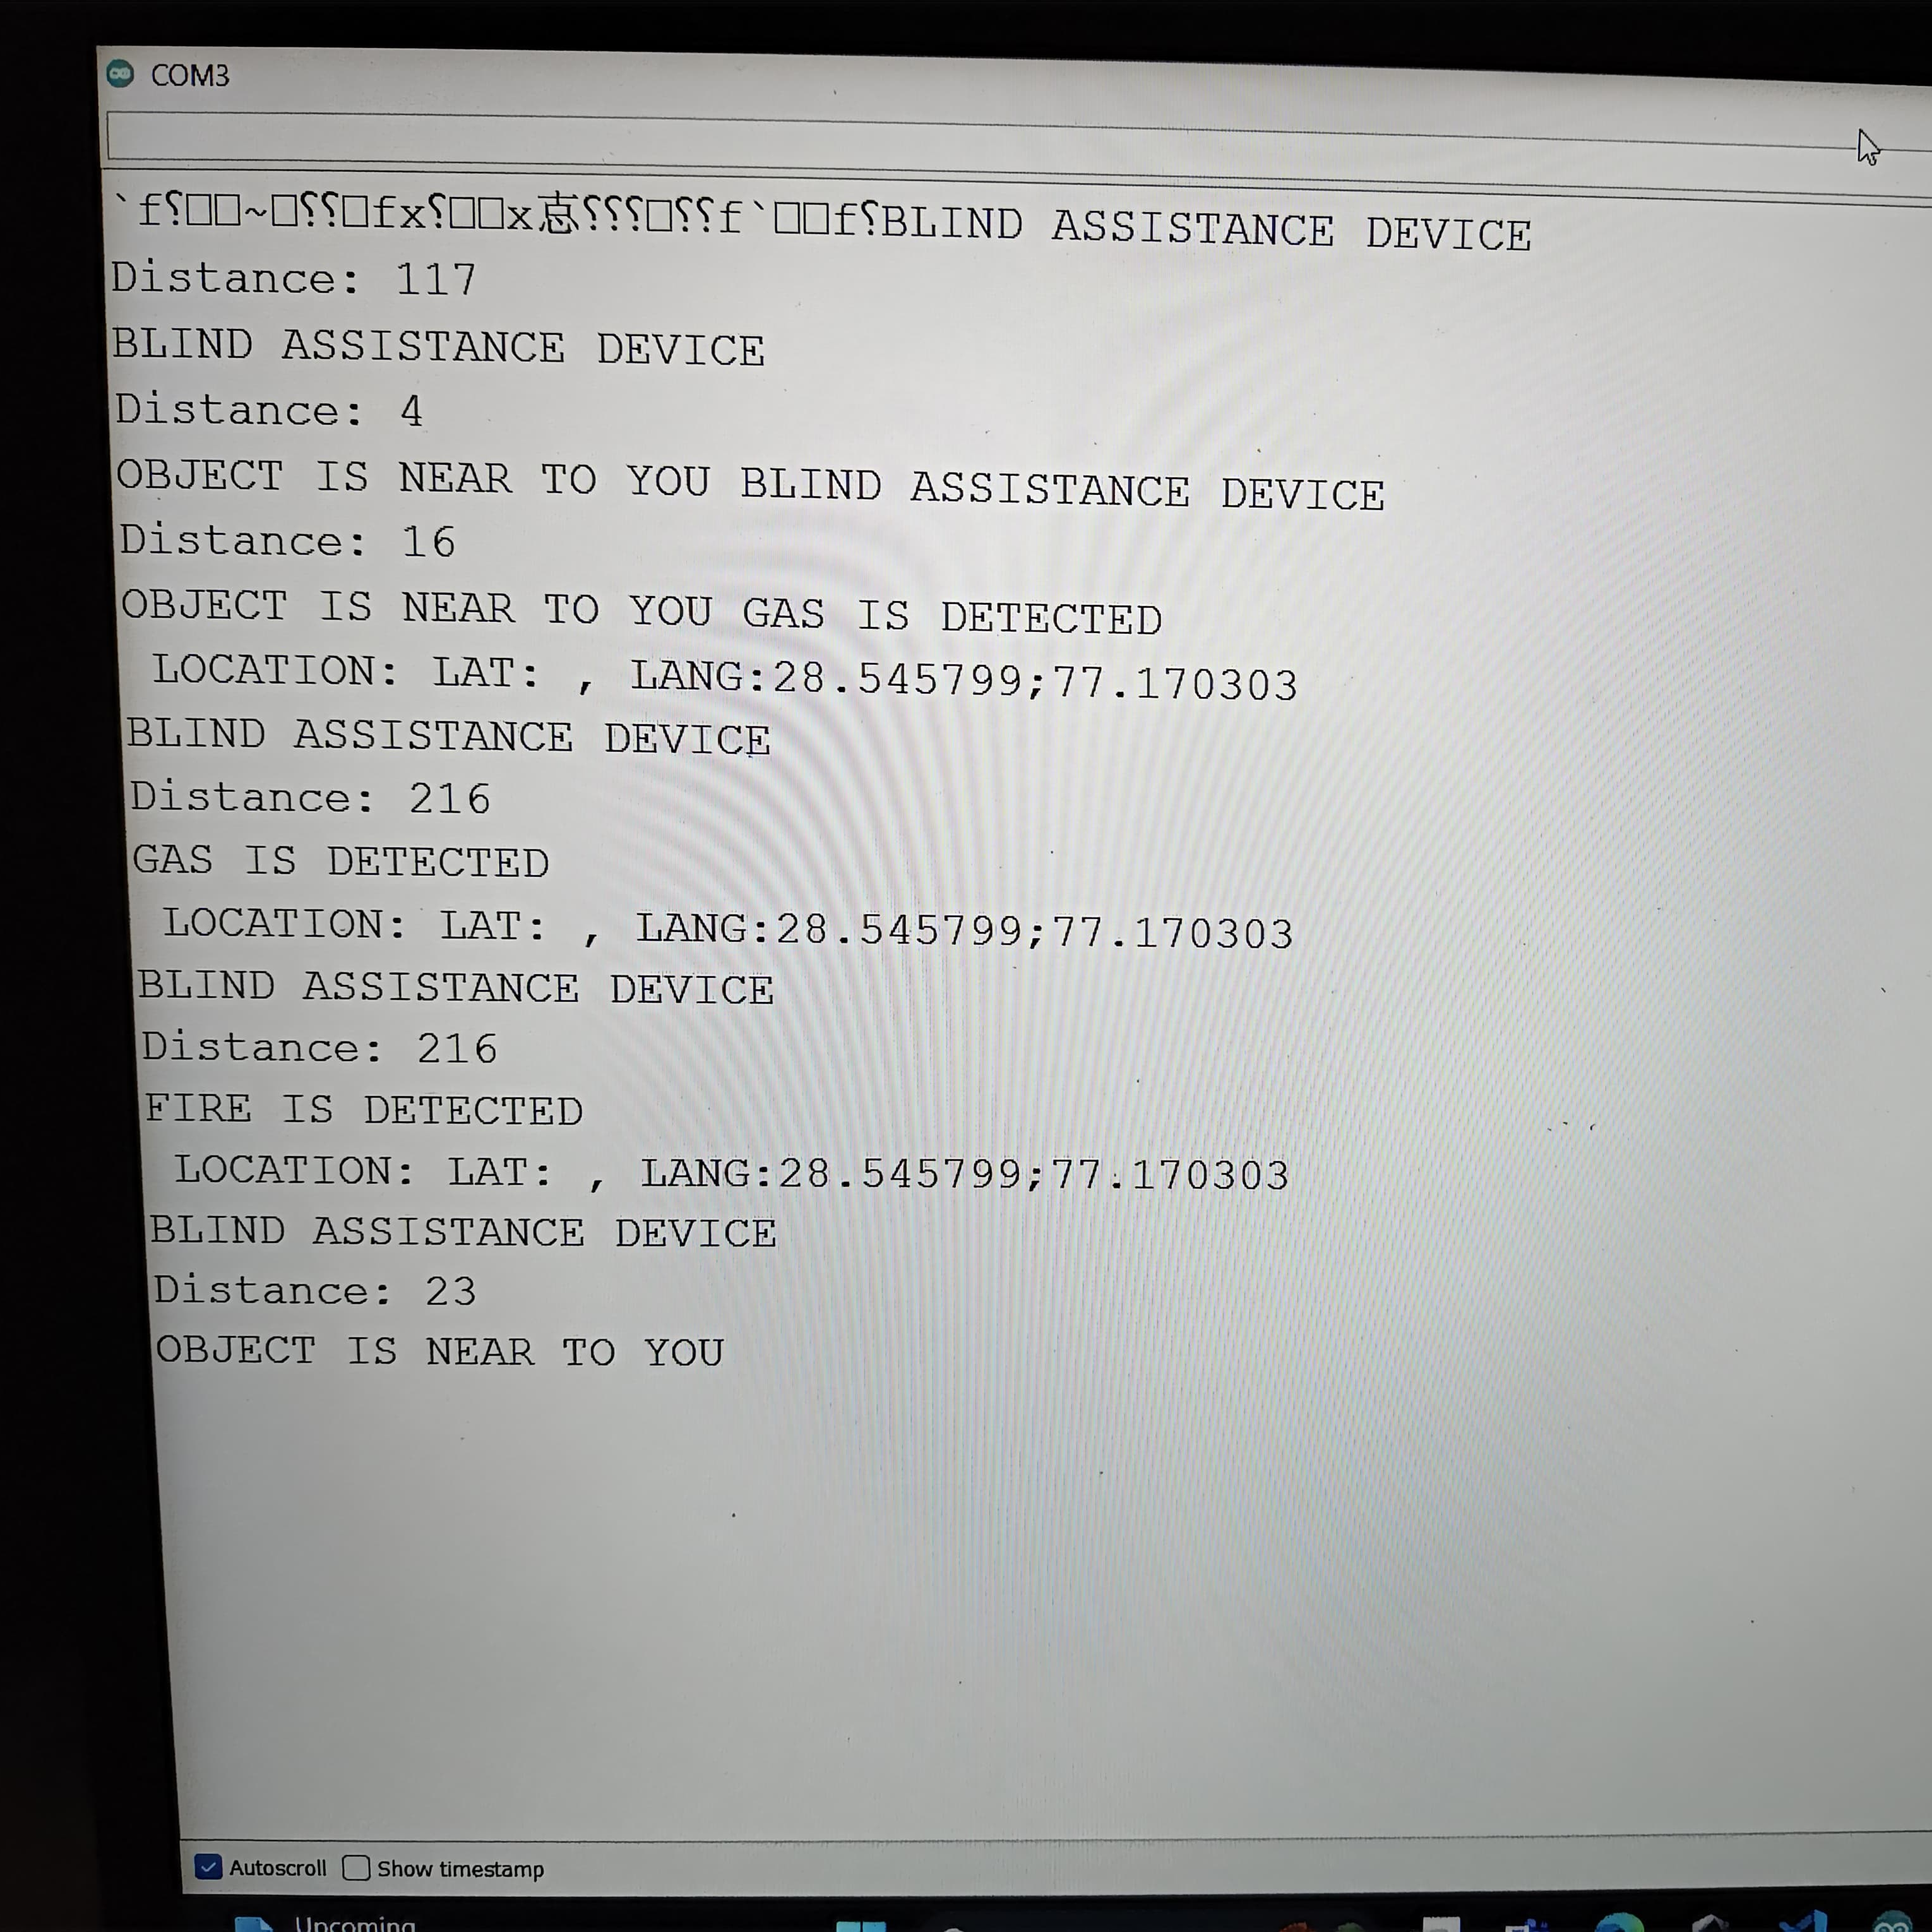
PROJECT IMPLEMENTATION
SERIAL MONITOR COM3
PROTOTYPE MODULE

Slide 15
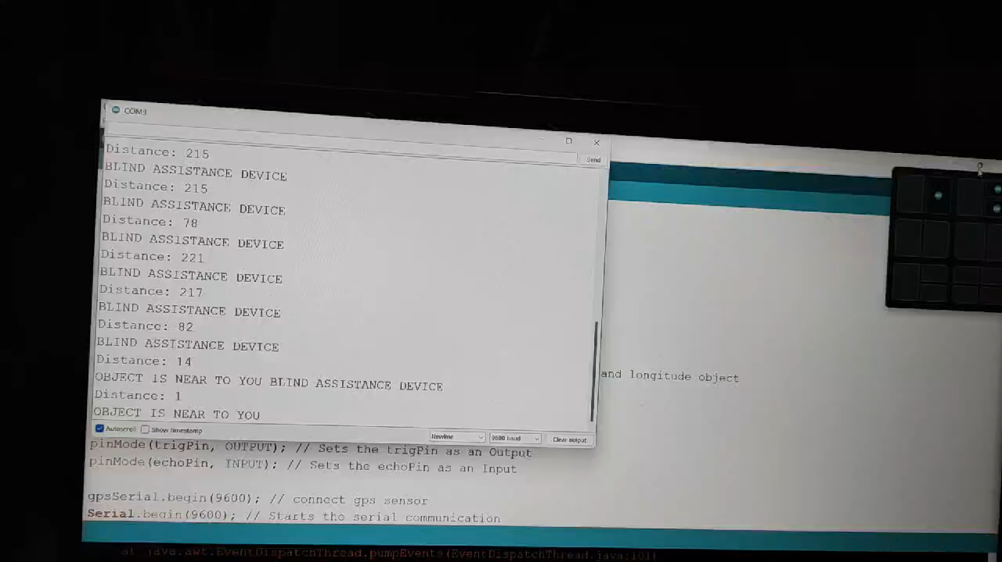
DEMO VIDEO

Slide 16
OBJECTIVES
Technology Integration: IoT and GPS technologies will be integrated to create a robust navigation system.
Real-time and Accurate Information: The system aims to provide up-to-date and precise location data to facilitate reliable navigation.
Context Awareness: The system will consider environmental factors and user preferences to offer context-aware navigation assistance.
Independence and Safety: The primary goal is to empower visually impaired individuals, promoting independent mobility while ensuring safety during navigation.
User-Friendly Interface: A user-friendly interface will be developed to make the navigation system accessible and easy to use for individuals with visual impairments.

Slide 17
ADVANTAGES OF EMPOWERING BLIND NAVIGATION USING IOT AND GPS TRACKING SYSTEM
Location Awareness
Obstacle Detection and Avoidance
Enhanced Independence
Customized Navigation Preferences
Hands-Free Operation with Voice Commands
Real-Time Feedback and Guidance
Global Accessibility
Improved Safety and Risk precautions

Slide 18
.
APPLICATIONS OF IOT AND GPS TRACKING SYSTEM:
Real-time Navigation Assistance: Utilizing GPS tracking, the system will offer precise location information and deliver turn-by-turn guidance, allowing users to navigate unfamiliar environments confidently.
Emergency Assistance: In case of emergency situations, the system can be programmed to provide guidance to the nearest exits or safe zones..
Indoor Navigation: Beyond outdoor navigation, the system can be adapted for indoor environments, such as shopping malls, airports, or large buildings.
public Transportation Access: Integrating GPS with public transportation systems allows users to access real-time information about the location and schedules of buses and trains.
Points of Interest Identification : Identifies and communicates points of interest, such as shops, public facilities, or specific locations, aiding users in exploring and interacting with their environment.

Slide 19
CONCLUSION
In conclusion, the integration of IoT and GPS tracking systems has demonstrated a groundbreaking potential in empowering blind individuals to navigate their surroundings with enhanced independence and safety. This innovative solution leverages real-time data, smart sensors, and geolocation technologies to provide a comprehensive navigation experience tailored to the unique challenges faced by the visually impaired.
Enhanced Spatial Awareness
Real-time Obstacle Detection
Customized Navigation Feedback
Integration of Voice Commands
Social Inclusion and Independence

Slide 20
REFERENCES
[1] J. Balata, J. Franc, Z. Mikovec, and P. Slavik, “Collaborative navigation of visually impaired,” Journal of Multimodal User Interfaces, vol. 8, no. 2, pp. 175-185, Jun. 2014.
[2] S. K. Kane, J. O. Wobbrock, and R. E. Ladner. “Usable gestures for blind people: understanding preference and performance.” Proceedings of the SIGCHI Conference on Human Factors in Computing Systems. ACM, pp. 413-422, 2011.
[3] “WHO - Visual impairment and blindness,” WHO. [Online]. Avail- able: http://www.who.int/mediacentre/factsheets/fs282/en/. [Accessed: 27-Feb-2015].
[4] B. Dias, “Localization, Route Planning, and Smartphone Interface for Indoor Navigation,” in Cooperative Robots and Sensor Networks, A. Kouba and A. Khelil, Eds. Springer Berlin Heidelberg, 2014, pp. 39-59.
[5] The various references taken in order to complete the project are listed here.
https://www.youtube.com/watch?v=KnLCkVib3u0
https://techatronic.com/smart-blind-stick-using-arduino-and-ultrasonic-sensor/
https://www.projectsof8051.com/gps-tracker-for-blind-people-using-gsm-technology/
www.electroduino.com

Slide 21
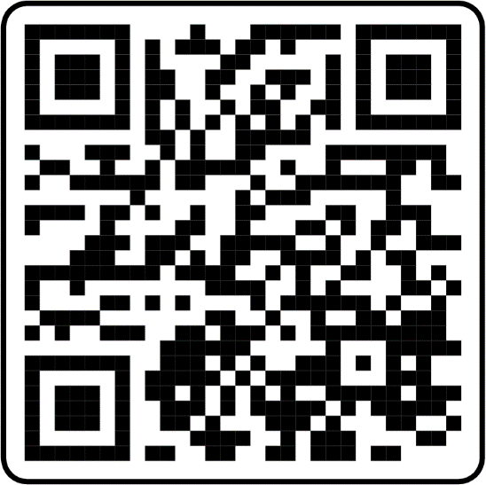

WEB-SITE QR code.
https://aliakbark001.github.io/Visually-Impaired-Assistance/

Slide 22
THANK YOU

